Slide 1
CS312
Artificial Intelligence
Lecture # 02
HITEC University, Taxila
Mr. Mubashir Iqbal
Fall-2025

Slide 2
Alan M. Turing
1912-1954

Slide 3
Turing Test – Measuring Machine Intelligence
Scientist & Year
Proposed by: Alan Mathison Turing (British Mathematician and Computer Scientist)
Year: 1950
Introduced in Paper: “Computing Machinery and Intelligence” published in the journal Mind.
Famous Question: “Can machines think?”

Slide 4
Turing Test – Definition
The Turing Test is a method to evaluate a machine’s ability to show human-like intelligence.
A machine passes the test if it can convince a human evaluator that it is also human through conversation — meaning the evaluator cannot reliably distinguish between the machine and a real human.

Slide 5
Turing Test – How It Works (Process)
Three participants:
  A Human Judge
  A Human Respondent
  A Machine (AI Program)
Interaction setup:
  The judge communicates with both the human and the machine through text (keyboard/screen) — so voice or appearance does not influence judgment.
Goal:
  The judge asks any questions (about general knowledge, opinions, feelings, etc.) to determine which participant is human.
Machine’s Objective:
  To respond intelligently and naturally enough that the judge mistakes it for a human.

Slide 6


Science Fiction Movie Example
“Ex Machina” (2015)
  A realistic portrayal of the Turing Test concept.
  A scientist designs a humanoid robot named Ava, and a human is asked to test if Ava can truly think and feel like a human.
  The film explores consciousness, deception, and self-awareness — all core themes of the Turing Test.
Blade Runner 2049
Her (2013) – explores emotional intelligence of AI.

Slide 7
Turing Test
Evaluation Criteria
If the machine can fool the human in more than 30% of the trials, it is considered to have passed the Turing Test.
The focus is on behavioral intelligence, not how the machine works internally.
Evaluation is subjective, based on how “human-like” the responses appear.
Example Questions in a Turing Test
“What’s your favorite food?”
“How do you feel about the weather today?”
“Can you tell me a joke?”
The AI’s ability to give natural, emotional, and context-aware answers is what determines success.

Slide 8

The Imitation Game
Reverse Engineering of Enigma
In 1939, newly created British intelligence agency MI6 recruits Cambridge mathematics Alan Turing to crack Nazi codes, including Enigma -- which cryptanalysts had thought unbreakable.
Turing's team, including Joan Clarke (Keira Knightley), analyze Enigma messages while he builds a machine to decipher them.
Turing and team finally succeed and become heroes.

Slide 9
Alan M. Turing
“Computing Machinery and Intelligence” 1950
Mind; A Quarterly Review of Psychology and Philosophy
Volume 59, Number 236, pp 433 – 460
Cryptography
“Enigma”
Mathematician

Slide 10



Turing Test
Imagine a game
played by 3
people.
Man
Interrogator
Woman

Slide 11
Turing Test
Man
Interrogator
Woman

Slide 12

Turing Test
Man
Interrogator
Woman

Slide 13

Turing Test
Man
Interrogator
Woman

Slide 14
Turing Test
I must convince the interrogator that I am a woman.
Man
Interrogator
Woman

Slide 15
Turing Test
I’m a woman!
Man
Interrogator
Woman

Slide 16
Turing Test
I must convince the interrogator that I am a woman.
Man
Interrogator
Woman

Slide 17
Turing Test
I’m a woman!
Man
Interrogator
Woman

Slide 18
Turing Test
Ask any question
Man
Interrogator
Woman

Slide 19
Turing Test
Allowed any answer.
Man
Interrogator
Woman

Slide 20
Turing Test
Man
Ask any question
Interrogator
Woman

Slide 21
Turing Test
Man
Allowed any answer.
Interrogator
Woman

Slide 22
Turing Test
Deception is allowed
by everyone.
Man
Interrogator
Woman

Slide 23

Turing Test
Now replace one
person …
Man
Interrogator
Woman

Slide 24

Turing Test
with a machine.
Note that the “man”
is now just a
“human”
Human
Interrogator
Machine

Slide 25
Turing Test
Similar rules
apply.
Human
Interrogator
Machine

Slide 26
Turing Test
I must convince the interrogator that I am a human.
Human
Interrogator
Machine

Slide 27
Turing Test
I must convince the interrogator that I am a human.
Human
Interrogator
Machine

Slide 28

Turing Test
$$objective_function()$$
Human
Interrogator
Machine

Slide 29
Turing Test
I must convince the interrogator that I am a human.
I must determine if I am communicating with a human
I must convince the interrogator that I am a human.
Human
Interrogator
Machine

Slide 30
Turing Test
I must determine if I am communicating with a human
I must convince the interrogator that I am a human.
Ask any question
Provide any answer
Machine
Interrogator
No holds barred!

Slide 31

Turing Test
I must convince the interrogator that I am a human.
I must determine which one is a human
I must determine if I am communicating with a human
I must convince the interrogator that I am a human.
Human
Interrogator
Machine

Slide 32
Turing Test
I must convince the interrogator that I am a human.
I must determine if I am communicating with a human
Ask any question
Provide any answer
Interrogator
Man
No holds barred!

Slide 33
Turing Test
I must determine if I am communicating with a human
I must convince the interrogator that I am a human.
Ask any question
Provide any answer
Machine
Interrogator

Slide 34
Turing Test
I must determine if I am communicating with a human
I must convince the interrogator that I am a human.
Ask any question
Provide any answer
Machine
Interrogator

Slide 35
Turing Test
I must determine if I am communicating with a human
I must convince the interrogator that I am a human.
Ask any question
Provide any answer
Machine
Interrogator
NOTE: Turing did not specify sufficiently explicit test success criteria to devise a formal test.

Slide 36
Turing’s Speculation
Speculation: the forming of a theory or conjecture without firm evidence
“I believe that in about fifty years’ time it will be possible to programme computers, with large storage capacity of about, to make them play the imitation game so well that an average interrogator will not have more than 70 per cent. chance of making the right identification after five minutes of questioning.”
Turing, Alan M. "Computing machinery and intelligence." Mind 59.236 (1950): 433-460.

Slide 37
Turing Test
I must determine if I am communicating with a human
I must convince the interrogator that I am a human.
Ask any question
Provide any answer
Machine
Interrogator
Turing Test: 70% success after 5 minutes?

Slide 38
Intelligent Agents

Slide 39
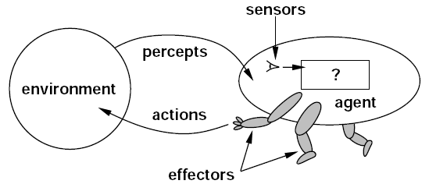
Intelligent Agents
Agents and Environments
An agent is anything (an entity) that can be viewed as perceiving its environment through sensors and acting upon that environment through actuators.
Notes:
F: Agent function (the decision-making logic)
P*Percept history (all past observations of the agent)
AAction (the response the agent takes)
The equation f : P* → A describes how an AI agent functions in decision-making.
The agent function (f) takes the history of percepts (P*) as input.It then decides on the best action (A) to take.The agent does not just react to the current state but considers past experiences (P*) to improve decision-making.
Example 2: Self-Driving Car (Tesla Autopilot)
Percept history (P*) = Camera & sensor data from past driving sessions.
Agent function (f) = AI decision-making algorithm (neural network).
Action (A) = Adjust speed, turn, or stop.

Slide 40
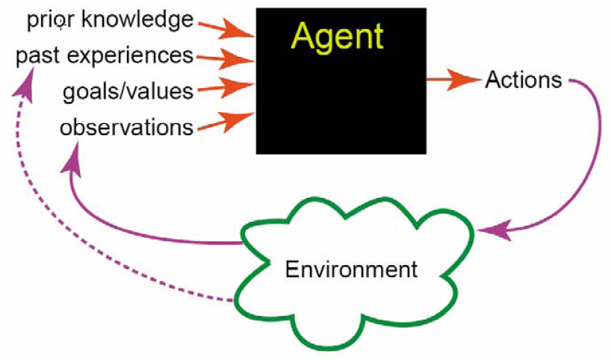
Agents Acting in an Environment

Slide 41
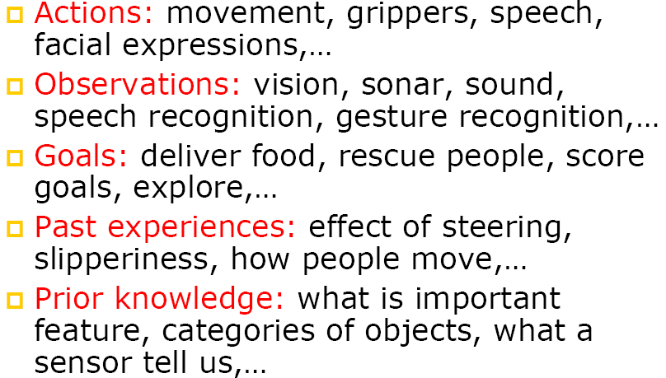
Example Agent: Robot

Slide 42
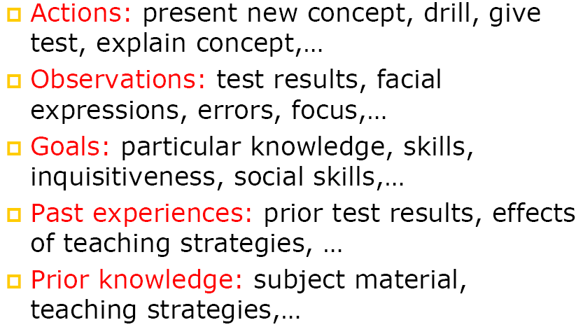
Example Agent: Teacher
Notes:
Prior Knowledge – Information that is pre-programmed into the AI.
Past Experience – Information that the AI learns from its environment over time.
A self-driving car knows the rules of the road before driving.
A chess-playing AI knows the rules of chess before it starts playing.
A robot knows object categories (e.g., what is a door, table, human).
A self-driving car learns from past mistakes (e.g., braking too hard).
A chatbot learns new slang words from user interactions.
A robot adjusts how much force to use when picking up objects.

Slide 43
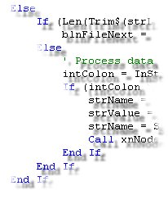
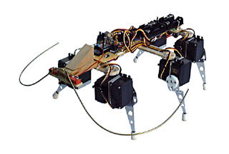
Examples of Agents
Humans Programs/PC Robots___
senses keyboard, mouse, dataset cameras, pads
body parts monitor, speakers, files motors, limbs

Slide 44
Intelligent Agents
A human agent has eyes, ears, and other organs for sensors, and hands, legs, mouth, and other body parts for actuators.
A robotic agent might have cameras and infrared range finders for sensors and various motors for actuators.
A software agent receives keystrokes, file contents, and network packets as sensory inputs and acts on the environment by displaying on the screen, writing files, and sending network packets.

Slide 45
Types of Agent

Slide 46
Types of Agent Programs
  Simple Reflex Agents
  Model-Based Reflex Agents
  Goal-Based Reflex Agents
  Utility-Based Agents
  Learning Agents

Slide 47
Types of Agent Programs
1. Simple Reflex Agent
The simplest kind of agent is the simple reflex agent.
These agents select actions on the basis of the current percept, ignoring the rest of the percept history.
Select action on the basis of only the current percept.
Implemented through condition-action rules.

Slide 48
Types of Agent Programs
1. Simple Reflex Agent
Characteristics
  Very limited knowledge or intelligence
  Only works if the environment is fully observable.
  Lacking history, (operating in partially observable environment)
  Easily get stuck in infinite loops.

Slide 49
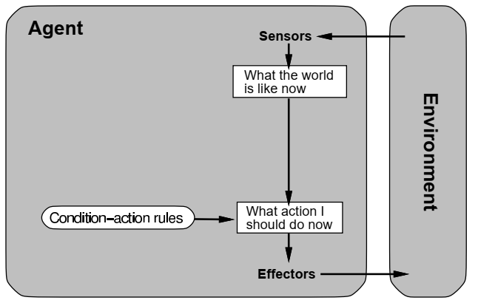
Types of Agent Programs
1. Simple Reflex Agent
  Simplex Reflex Agent: Schema

Slide 50
Types of Agent Programs
2. Model-Based Reflex Agents
The most effective way to handle partial observability is for the agent to keep track of the part of the world it can't see now.
That is, the agent should maintain some sort of internal state/memory.
  that depends on the percept history and thereby reflects at least some of the unobserved aspects of the current state.

Slide 51
Types of Agent Programs
2. Model-Based Reflex Agents
Self-driving cars are a great example of a model-based reflex agent.
The car is equipped with sensors that detect obstacles, such as car brake lights in front of them or pedestrians walking on the sidewalk.
As it drives, these sensors feed percepts into the car’s memory and internal model of its environment.

Slide 52
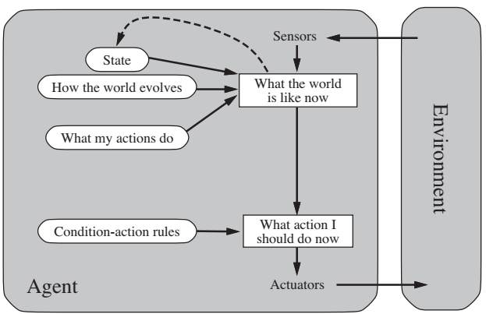
Types of Agent Programs
2. Model-Based Reflex Agents

Slide 53
Types of Agent Programs
3. Goal-Based Agents
Knowing about the current state of the environment is not always enough to decide what to do.
  For example, at a road junction, the taxi can turn left, turn right, or go straight on. The correct decision depends on where the taxi is trying to get to.
The agent needs some sort of goal information that describes situations that are desirable.
  For example, being at the passenger’s destination.

Slide 54
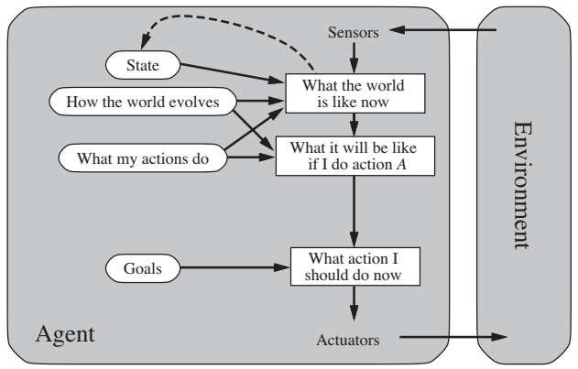
Types of Agent Programs
3. Goal-Based Agents

Slide 55
Types of Agent Programs
4. Utility-Based Agents
Goals alone are not really enough to generate high-quality behavior in most environments.
  For example, there are many action sequences that will get the taxi to its destination (thereby achieving the goal) but some are quicker, safer, more reliable, or cheaper than others.

Slide 56
Types of Agent Programs
4. Utility-Based Agents
Goals just provide a basic difference between “happy” and “unhappy” states.
A more general performance measure should allow a comparison of different world states according to exactly how happy they would make the agent if they could be achieved.
  Because “happy” does not sound very scientific, the customary terminology is to say that if one world state is preferred to another, then it has higher utility for the agent.

Slide 57
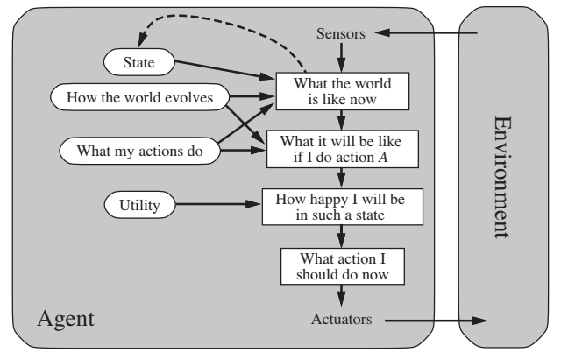
Types of Agent Programs
4. Utility-Based Agents

Slide 58
Types of Agent Programs
5. Learning Agent
All agents can improve their performance through learning.
A learning agent can be divided into four conceptual components, as:
  Learning element- responsible for making improvements
  Performance element– responsible for selecting external actions.
  Critic- The learning element uses feedback from the critic on how the agent is doing and determines how the performance element should be modified to do better in the future.
  Problem generator- and it is responsible for suggesting actions that will lead to new and informative experiences.

Slide 59
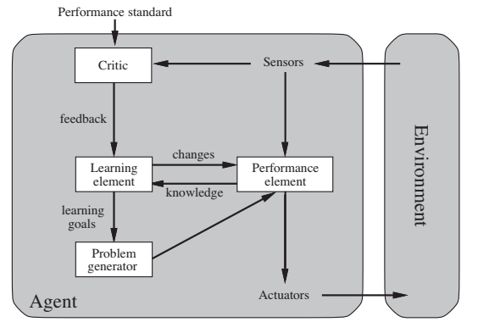
Types of Agent Programs
5. Learning Agent
  Schematic Diagram of Learning Agent is given below:

Slide 60
Rational Agents
A rational agent is one that does the right thing
Need to be able to calculate agent’s performance
  Should be independent of internal measures
Ask yourself: has the agent acted rationally?
  Not just dependent on how well it does at a task
First consideration: evaluation of rationality

Slide 61
Autonomy in Agents
The autonomy of an agent is the extent to which its
behaviour is determined by its own experience
Extremes
  No autonomy – ignores environment/data
  Complete autonomy – no internal knowledge
Example – Baby learning to crawl
Ideal – design agents to have some autonomy
  Possibly good to become more autonomous in time

Slide 62
Performance, Environment, Actuators, Sensors
(PEAS)

Slide 63
PEAS in AI (Performance Measure, Environment, Actuators, Sensors)
PEAS is a framework used to define and evaluate an AI agent’s environment and functionality.
It helps in designing intelligent agents by clearly specifying how they perceive the world, what actions they can take, and how their performance is measured.
It stands for:.
  Performance Measure: Output we get from the agent.
  Environment: All surrounding things and conditions.
  Actuators: Devices (hardware, software) through which agent performs actions on the environment
  Sensors: Devices from which agent perceives information from the environment.

Slide 64
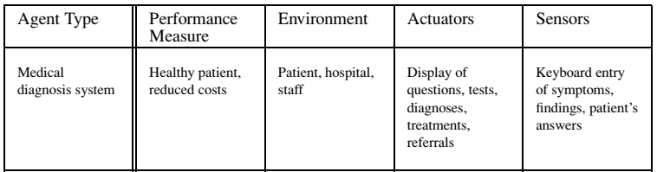
PEAS
In designing an agent, the first step must always be to specify the task environment as fully as possible.
The following table shows PEAS description of the task environment for a Medical Diagnosis System

Slide 65
Environment of an Agent

Slide 66
What is the Environment of an Agent
The environment is everything external to the agent that the agent interacts with.
It provides inputs (percepts) to the agent and receives outputs (actions) from the agent.
Example Environments:
For a self-driving car: roads, traffic lights, pedestrians, other cars.
For a chess-playing AI: the chessboard and opponent’s moves.
For a cleaning robot: room layout, dust, furniture, walls.

Slide 67
Agent Reflect Changes in the Environment
An intelligent agent continuously performs a sense → think → act cycle:
Sense: It perceives or collects data from the environment using sensors.
Think: It analyses that data and decides what action to take.
Act: It executes an action that may change the environment.
Learn: It observes the result of its action and updates its knowledge.
Example:
A self-driving car detects an obstacle (sense), decides to slow down (think), applies brakes (act), and then checks if the road is clear (learn).

Slide 68
Types of Environments in Artificial Intelligence
An environment is the world in which an agent operates.
Different AI applications (like robots, chatbots, or self-driving cars) exist in different kinds of environments, each having unique challenges.

Slide 69
Types of Environments in Artificial Intelligence
1. Fully Observable vs. Partially Observable
Fully Observable Environment:
  The agent has complete access to all relevant information about the environment’s state.
  It can make decisions confidently based on full data.
  Example: Chess game (the AI can see the entire board).
Partially Observable Environment:
  The agent can only see part of the environment at any given time.
  It must infer missing information using memory or estimation.
  Example: A self-driving car (cannot see blind spots or around corners).

Slide 70
Types of Environments in Artificial Intelligence
2. Deterministic vs. Stochastic
Deterministic Environment:
  Every action has a predictable and fixed outcome.
  No randomness is involved.
  Example: Solving a mathematical equation or playing checkers.
Stochastic/Non-Deterministic Environment:
  Outcomes are uncertain or probabilistic due to randomness.
  The agent must plan for multiple possible outcomes.
  Example: Stock market prediction, weather forecasting.

Slide 71
Types of Environments in Artificial Intelligence
3. Static vs. Dynamic
Static Environment:
  The environment does not change while the agent is making a decision.
  Time does not affect the agent’s reasoning.
  Example: Crossword puzzle (the puzzle remains the same).
Dynamic Environment:
  The environment changes over time, even while the agent is deciding.
  The agent must act quickly and update its perception frequently.
  Example: Driving in traffic or playing a real-time video game.

Slide 72
Types of Environments in Artificial Intelligence
4. Discrete vs. Continuous
Discrete Environment:
  Has a finite number of states, actions, or percepts.
  Decisions occur in different steps.
  Example: Chess, turn-based board games.
Continuous Environment:
  Involves infinite states and actions, where changes are smooth and gradual.
  Example: A robot moving through real-world space or a drone flying in 3D airspace.

Slide 73
Types of Environments in Artificial Intelligence
5. Single-Agent vs. Multi-Agent
Single-Agent Environment:
  Only one agent is acting in the environment.
  Example: A robot vacuum cleaner cleaning a room.
Multi-Agent Environment:
  Multiple agents operate and may cooperate or compete a task.
  Example: Online multiplayer games, autonomous car traffic, stock market trading bots.

Slide 74
Types of Environments in Artificial Intelligence
6. Episodic vs. Sequential
Episodic Environment:
  Each action is independent of previous actions.
  The agent does not need to remember the past.
  Example: Image classification (each image is a new episode).
Sequential Environment:
  Current decisions depend on previous actions and will affect future states.
  Example: Playing chess or navigating through a maze.

Slide 75
References
Artificial Intelligence”, by Elaine Rich and Kevin Knight, (2006), McGraw Hill companies Inc., Chapter 1-22 page 1-613.
“Artificial Intelligence: A Modern Approach” by Stuart Russell and Peter Norvig, (2009), Prentice Hall, Chapter 1-27. page 1-1151.
“Computational Intelligence: A logical Approach”, by David Poole, Alan Mackworth, and Randy Goebel, (1998), Oxford University Press, Chapter 1-12, page 1-608.
“Artificial Intelligence: Structures and Strategies for Complex Problem Solving”, by George F.Lugar, (2002), Addison-Wesley, Chapter 1-16, page 1-743.
“AI: A new Synthesis”, by Nils J.Nilsson, (1998), Morgan Kaufmann Inc., Chapter 1-25, Page 1-493.
“Artificial Intelligence: Theory and Practice” by Thomas Dean, (1994), Addison-Wesley, Chapter 1-10, Page 1-650.
Related documents from open source, mainly internet.

Slide 76

Not included in Syllabus
If you are taking a Nap, wake up........Lecture Over

Slide 77


